Slide 1
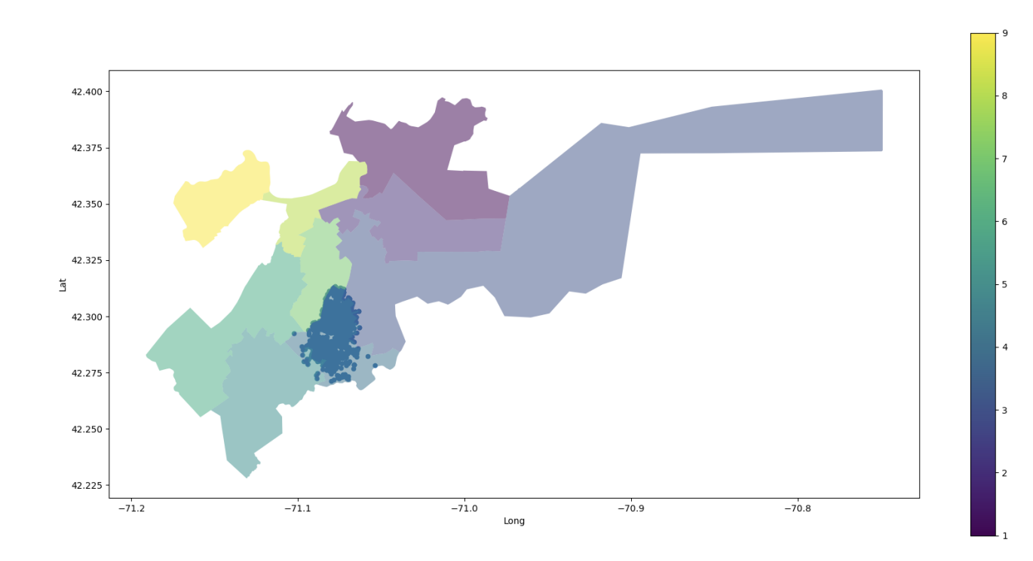
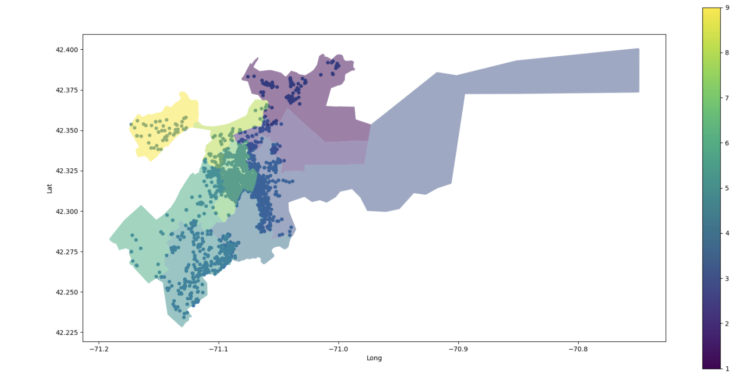
Gun Violence in Boston
—Councilor Worrell, a Boston City Councilman for District 4
Team: Sai Surya Varshith, Hitanshi Jain, Peiying Ye, Yuhe Bian
Motivation
Gun violence is a severe social problem in the United States, so it is important to understand this problem to come up with plausible solutions.
The results can inform city-wide strategies and improve public safety for residents of Boston.
Goal
Determine what drivers of violence looks like in District 4 as compared to other areas.
Understand the comparative volume and geographic distribution of gun violence in the district and beyond.

Slide 2
Division of Work
Datasets Used
Our Analysis
What is the rate of gun violence in District 4? How does this compare to the rest of the city?
Are there patterns of violence in terms of location in District 4? How does this compare to the rest of the city?
Refining previous analysis on Question 2 with more detailed explanation – Peiying
Pre-process for the extension data set —Yuhe
Worked on comparing gun violence in D4 and rest of the Boston city - Surya
Worked on comparing all the crime incidents in D4 and the Boston city - Hitanshi
Worked on visualizing year wise violences in Crime incidents data - Surya and Hitanshi
Districts for City Council Shapefile
Crime Incident Reports - Datasets - Analyze Boston
Police Records of Violence/Firearm Activity - Shots Fired, Shootings - Datasets - Analyze Boston

Slide 3
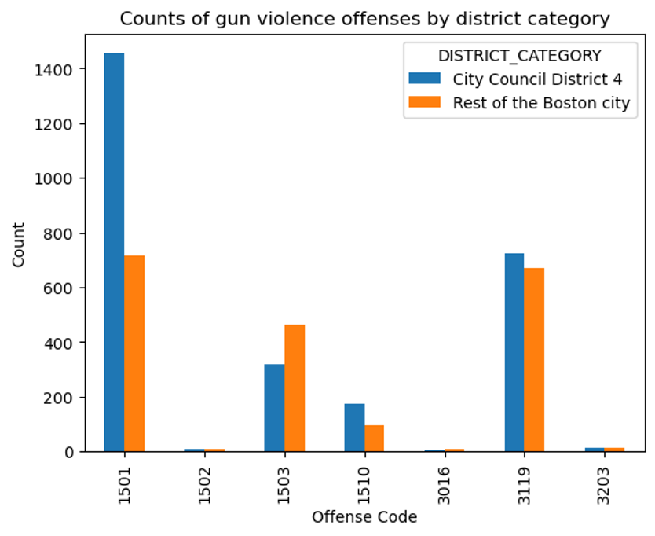
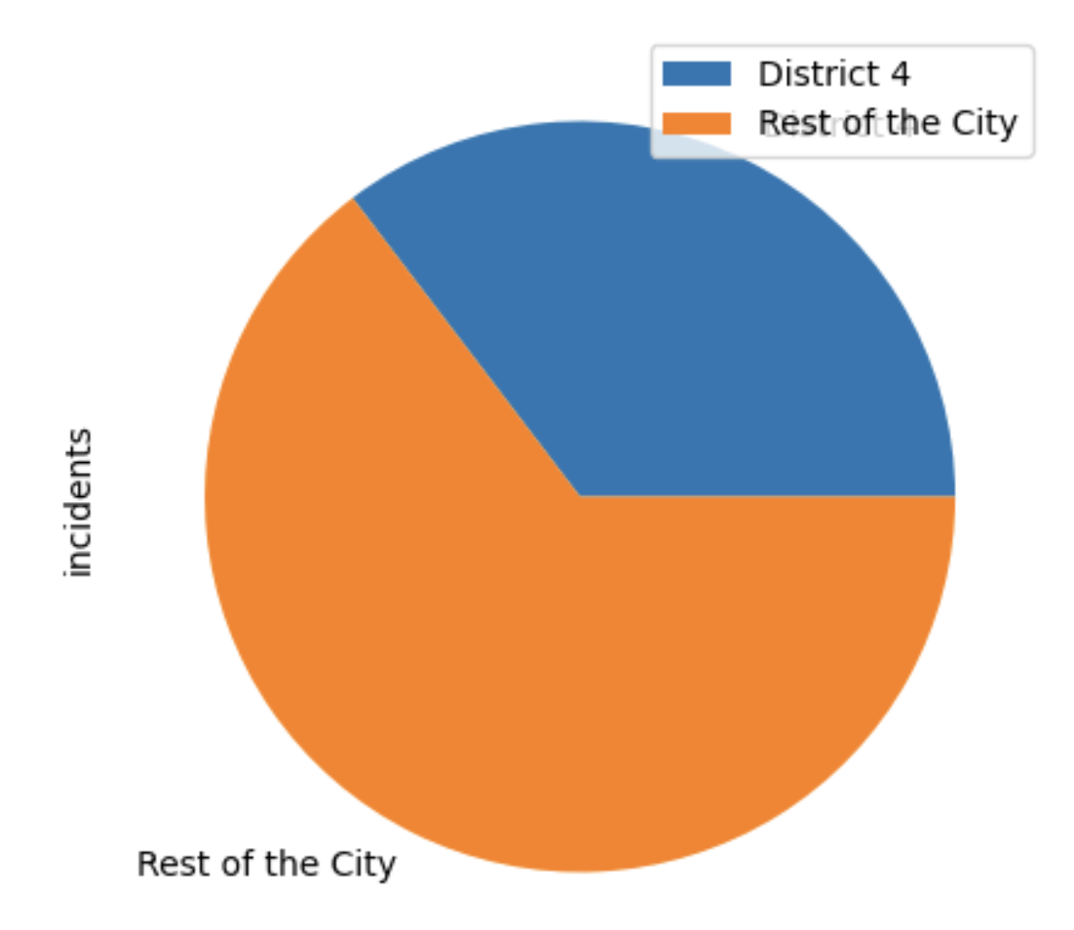
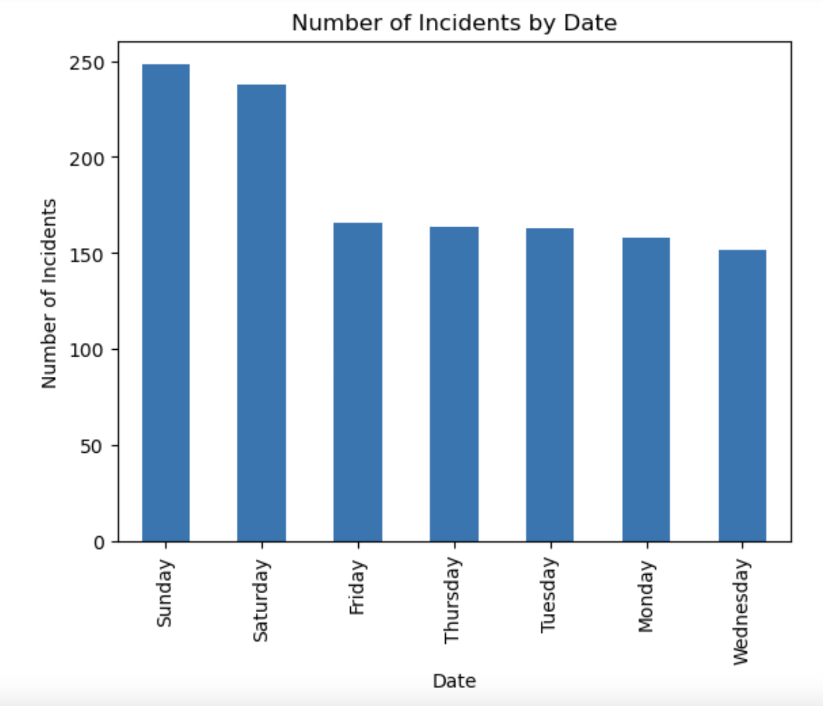
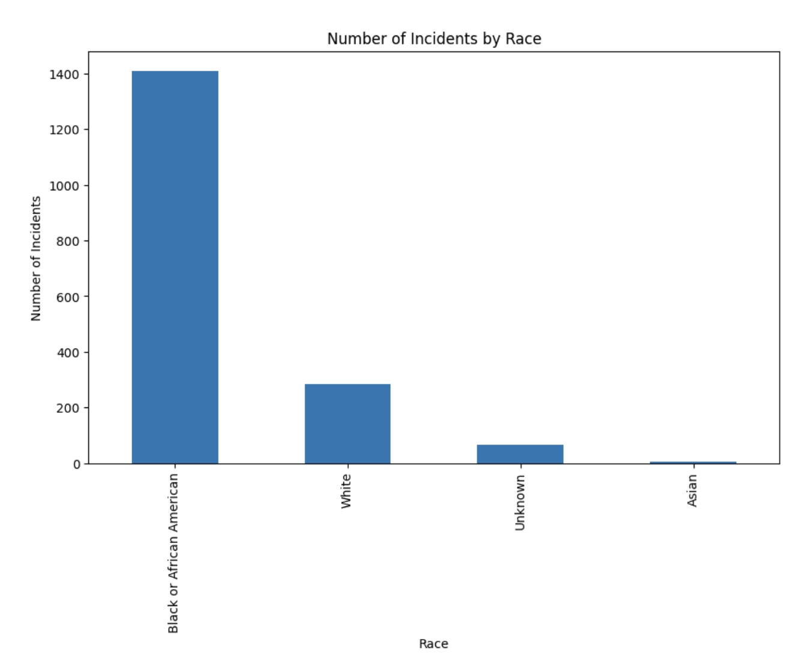
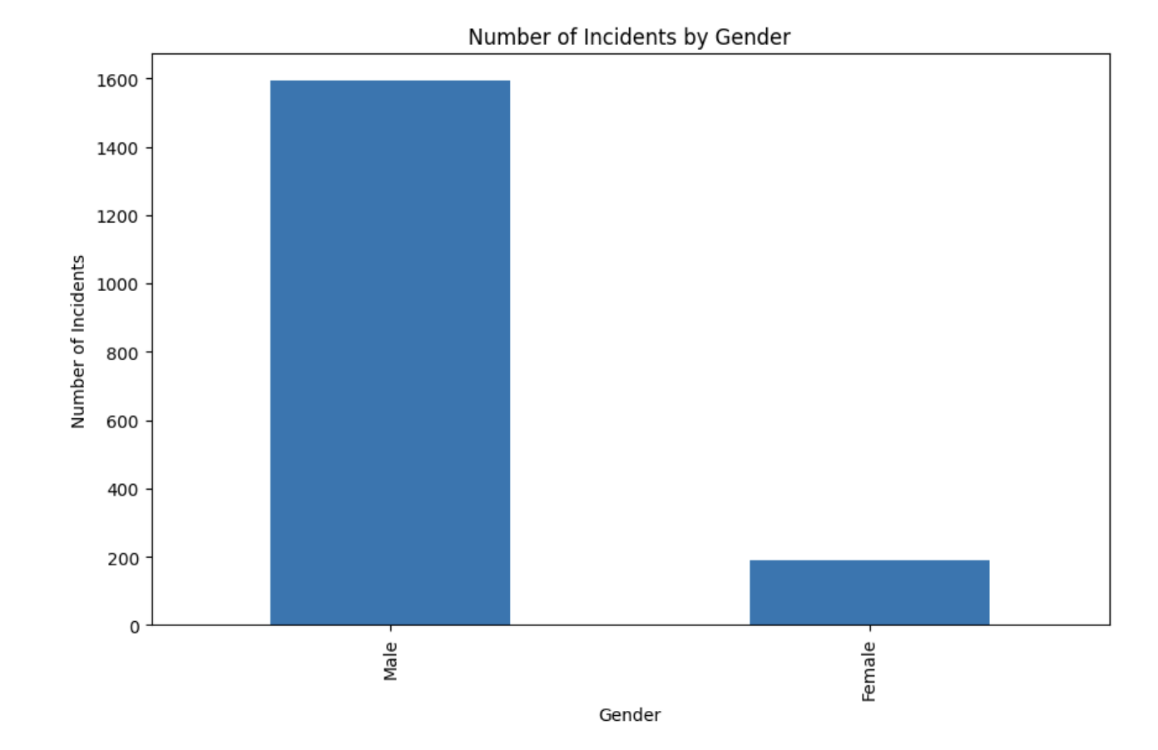
EARLY OBSERVATIONS
1501: WEAPON - FIREARM - CARRYING / POSSESSING, ETC
3203: FIREARM/WEAPON - LOST
1510: WEAPON - FIREARM - OTHER VIOLATION
3016: FIREARM/WEAPON - ACCIDENTAL INJURY / DEATH
3119: FIREARM/WEAPON - FOUND OR CONFISCATED
1502: WEAPON - FIREARM - SALE / TRAFFICKING
1503: WEAPON - OTHER - CARRYING / POSSESSING, ETC
Challenges:
Matching council district and police district
Figuring out possible correlation factors with gun violence
Notes:
Slide 3
What (early) results or observations do you have?
What (early) visualizations can you show?
What challenges did you encounter working with data?

Slide 4
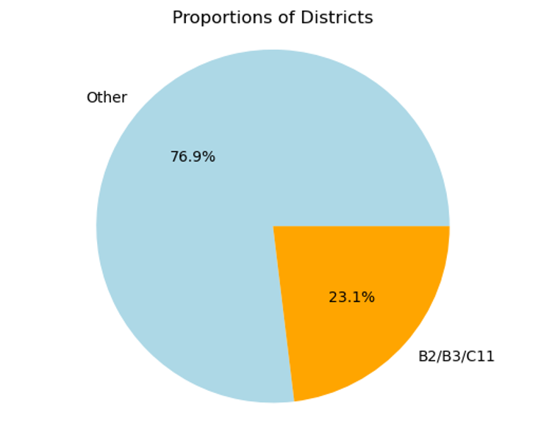
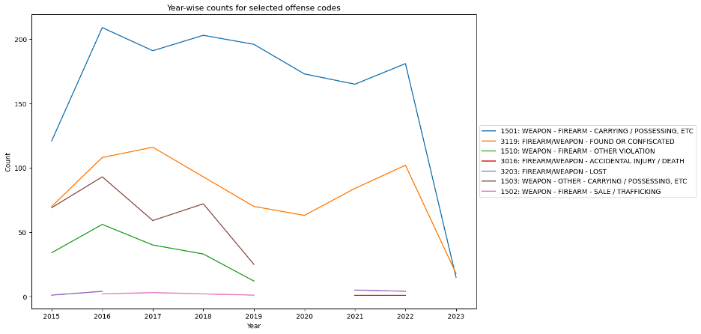
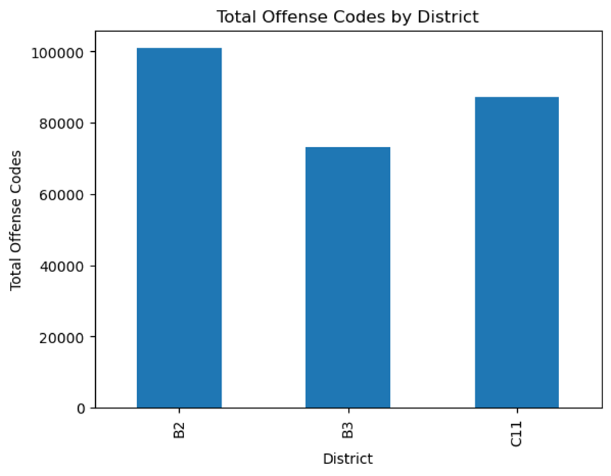
Gun violence offenses from 2015-2023 in district 4
Comparison of District 4 and Rest of Boston
Comparison within District 4 locations
Notes:
Slide 4
Any additional challenges you have encountered?
What limitations have you encountered? What assumptions have you had to make?
Based on the (early) results, what are the expected next steps?
What are you planning to do to complete your project?

Slide 5
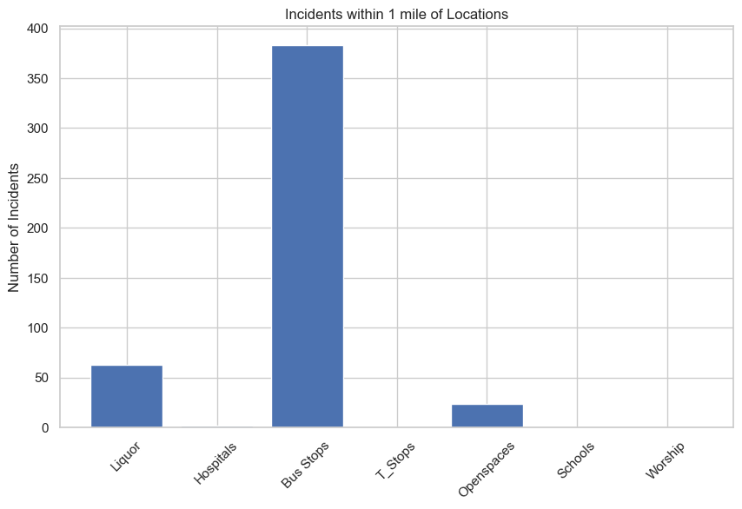
Extension Analysis
Liquor Stores: 63
Hospitals: 2
Bus Stops: 383
T-Stops: 0
Open Spaces: 24
Schools: 0
Places of Worship: 0

Slide 6
Conclusions
It can be seen that 3115 (INVESTIGATE PERSON) is the most frequently happening offense in the city of Boston while 619 (LARCENY ALL OTHERS) is the least occuring offense.
It can be seen that 1501 (WEAPON - FIREARM - CARRYING / POSSESSING) is the most occuring gun violence offense while 1502 (WEAPON - FIREARM - SALE / TRAFFICKING) is the least occuring gun violence offense.
B2 (Roxbury) has the highest while B3 (Mattapan) has the least number of offenses within the district 4.
The proportion of offences in district 4 locations which is 23.1% of the total offenses in the city of Boston.
Plans for next week
Work on analysis for the rest of the questions – Everyone
Figure out more dataset to perform analysis – Peiying
Collection and analysis for the extension data sets—Yuhe
Investigate the primary shooting hubs in D4 and determine if they are happening at public places or not. - Surya
Analyze the role of school students or age groups in incidents of gun violence. - Hitanshi

